Slide 1
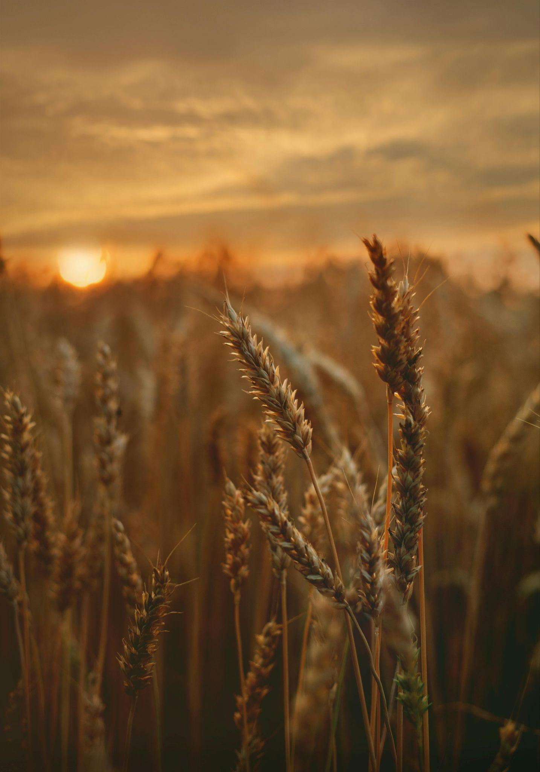
SmartFarm: IoT & Machine Learning for Farm Crop Yield Prediction
COMPE510 - Fall 2025
Undergraduate Team 3: Daniel Self, Ulises Urbina, Brandon Nguyen

Slide 2
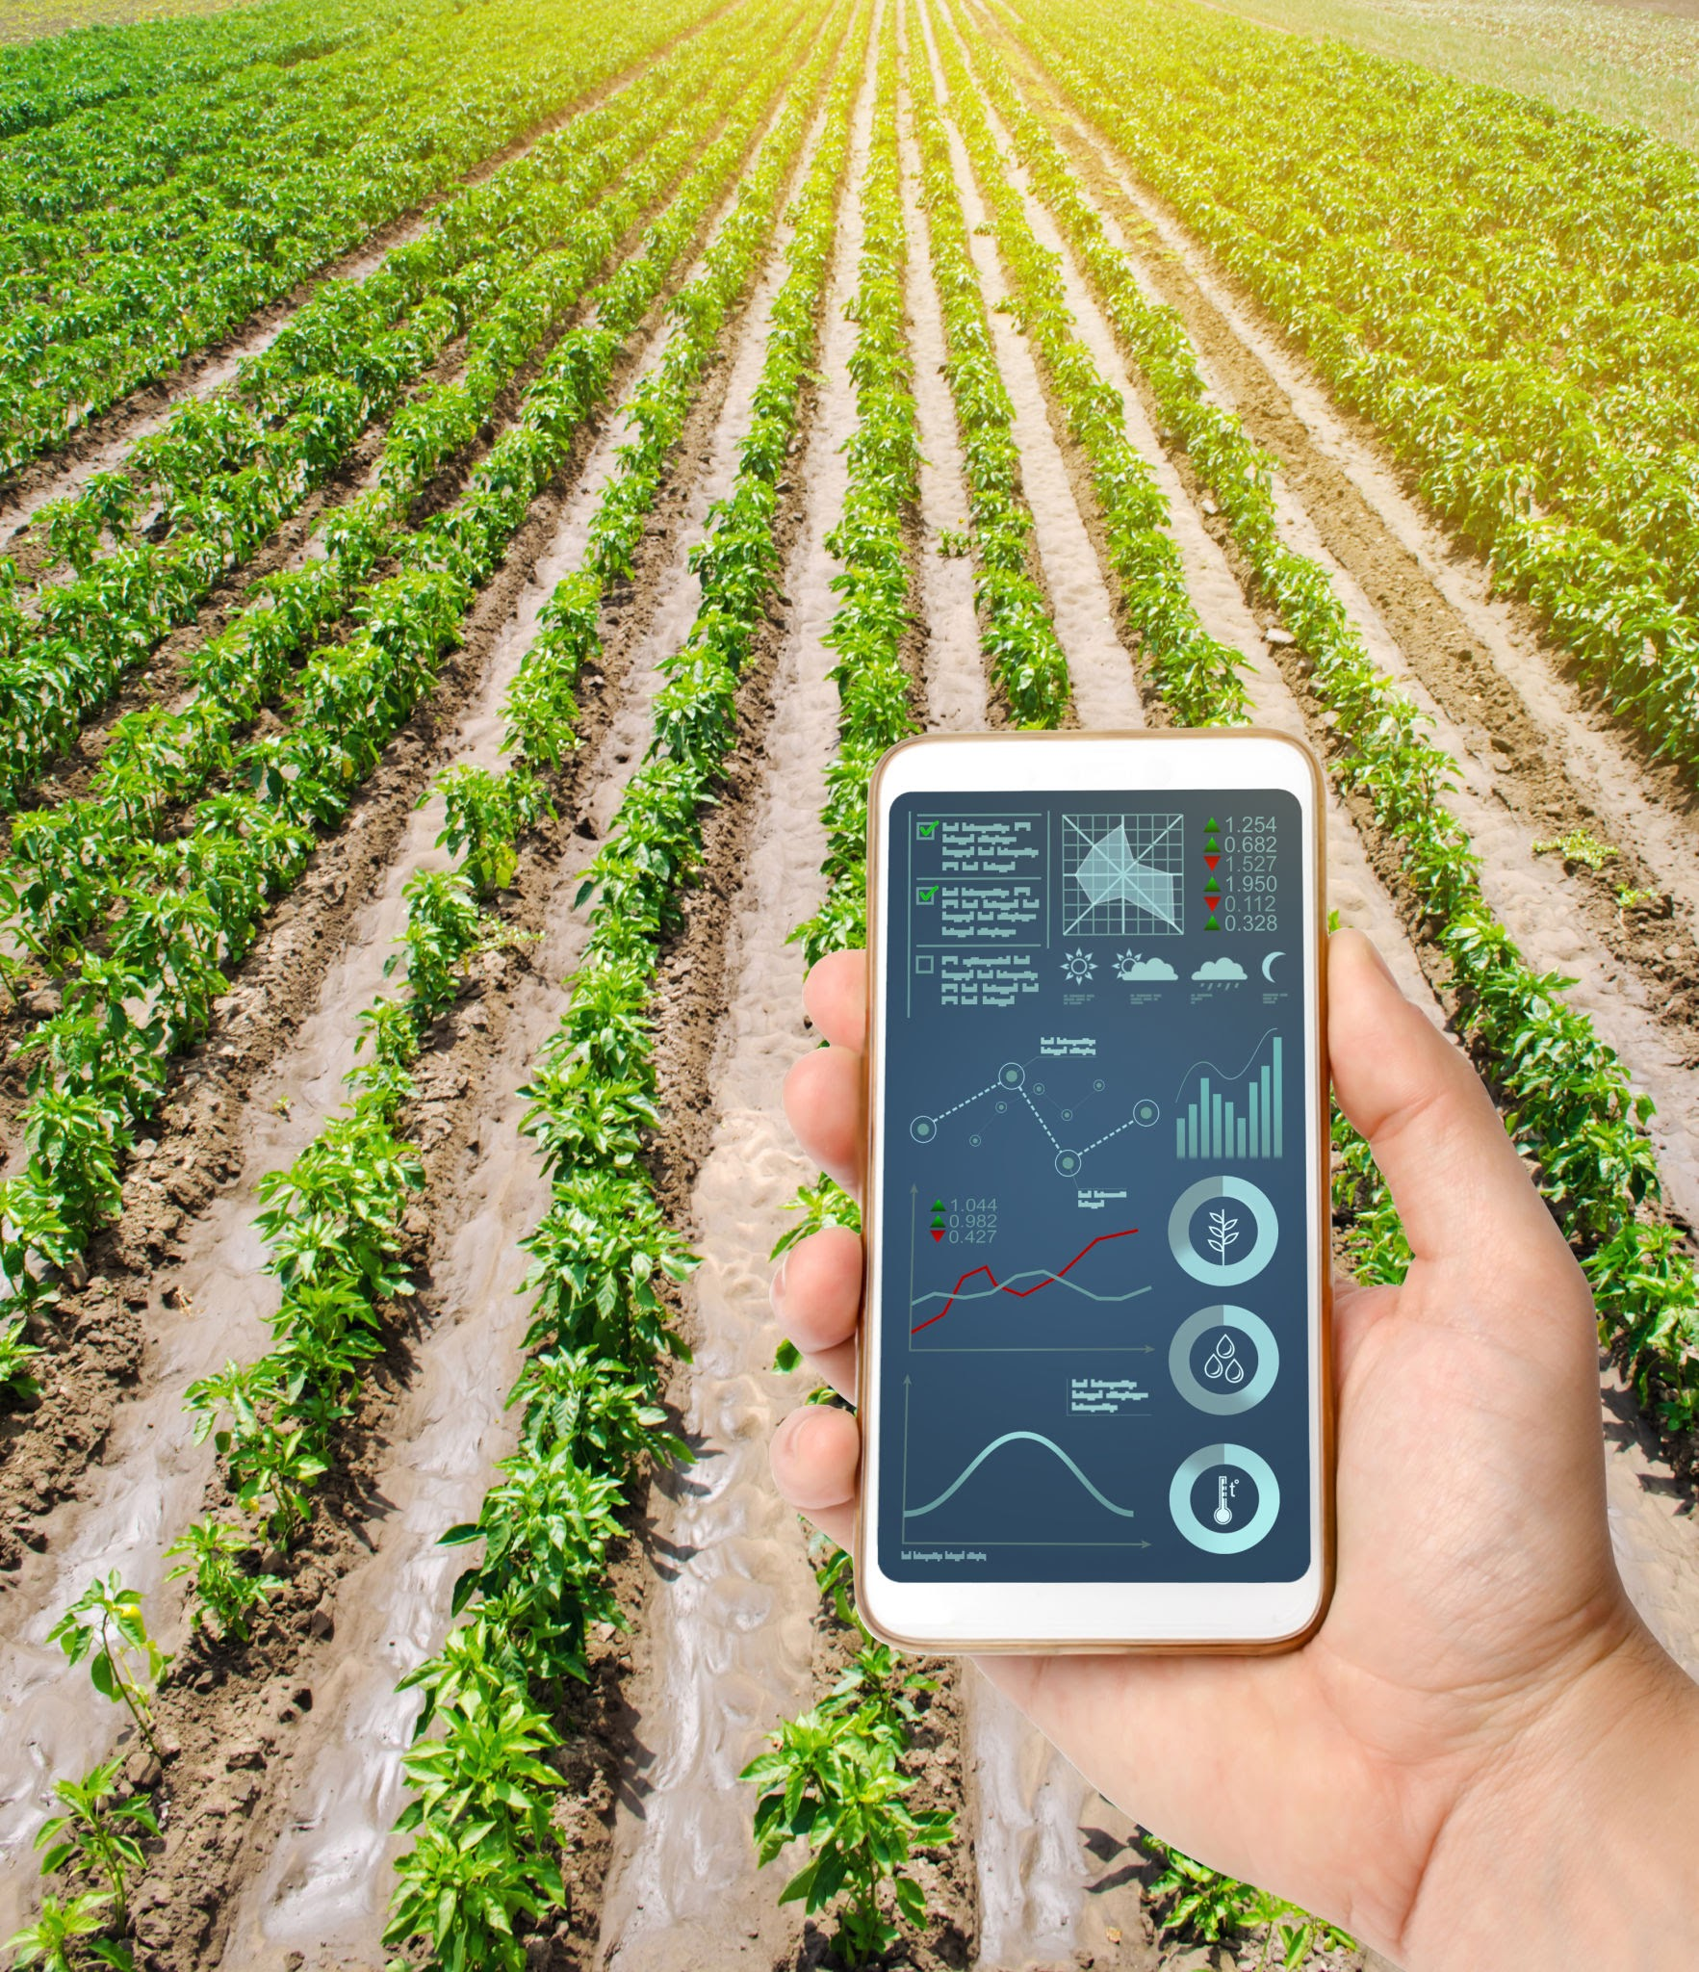
Overview
Problem:
It is difficult for farmers to forecast how much crop yield will be produced when there are many factors affecting crop growth.
Solution and Purpose:
Collect data across a wide range of environments using IoT sensors and satellite data, and train a machine learning algorithm on that data to predict crop yield.
Desired Outcome and Goals:
A working predictive algorithm trained on sensor and satellite data
Functional web/GUI program for users to input their data
Users will receive prediction results based on their data

Slide 3
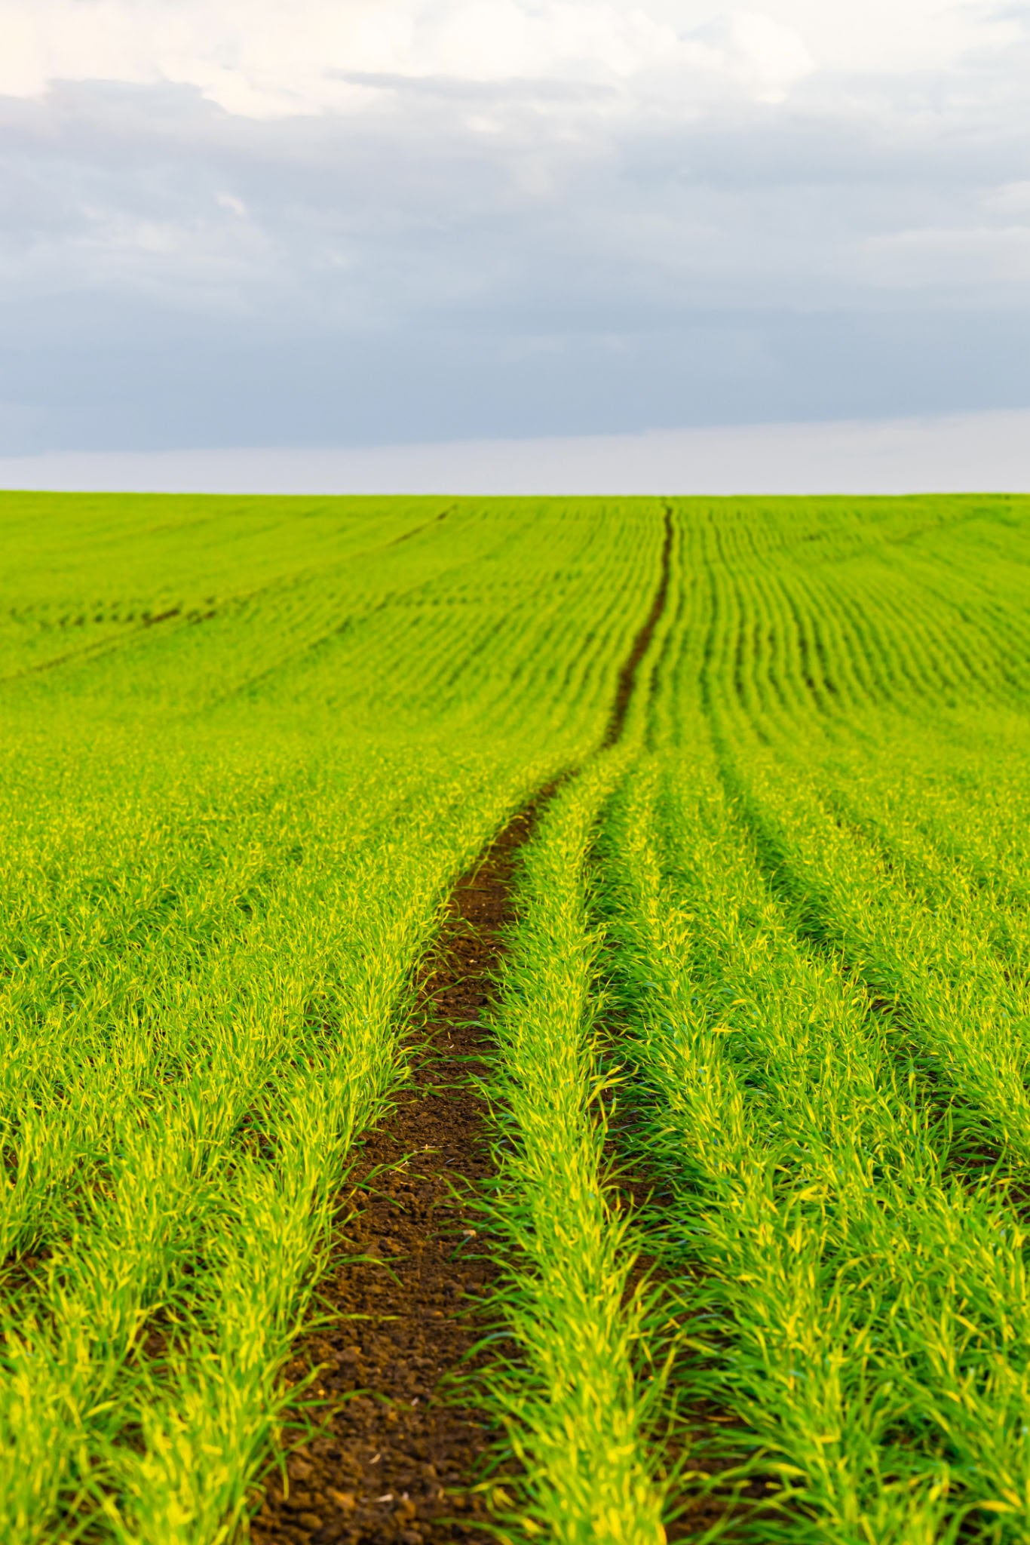
Resources
Main Datasheet:
Smart Farming Sensor Data for Yield Prediction via Kaggle
Data collected across multiple farms in countries like US, India, and Africa.
IoT sensors and satellite data
Predictive modeling using ML/AI
Time-series analysis
Sensor-based optimization
Environmental data visualizations
Crop health analytics

Slide 4
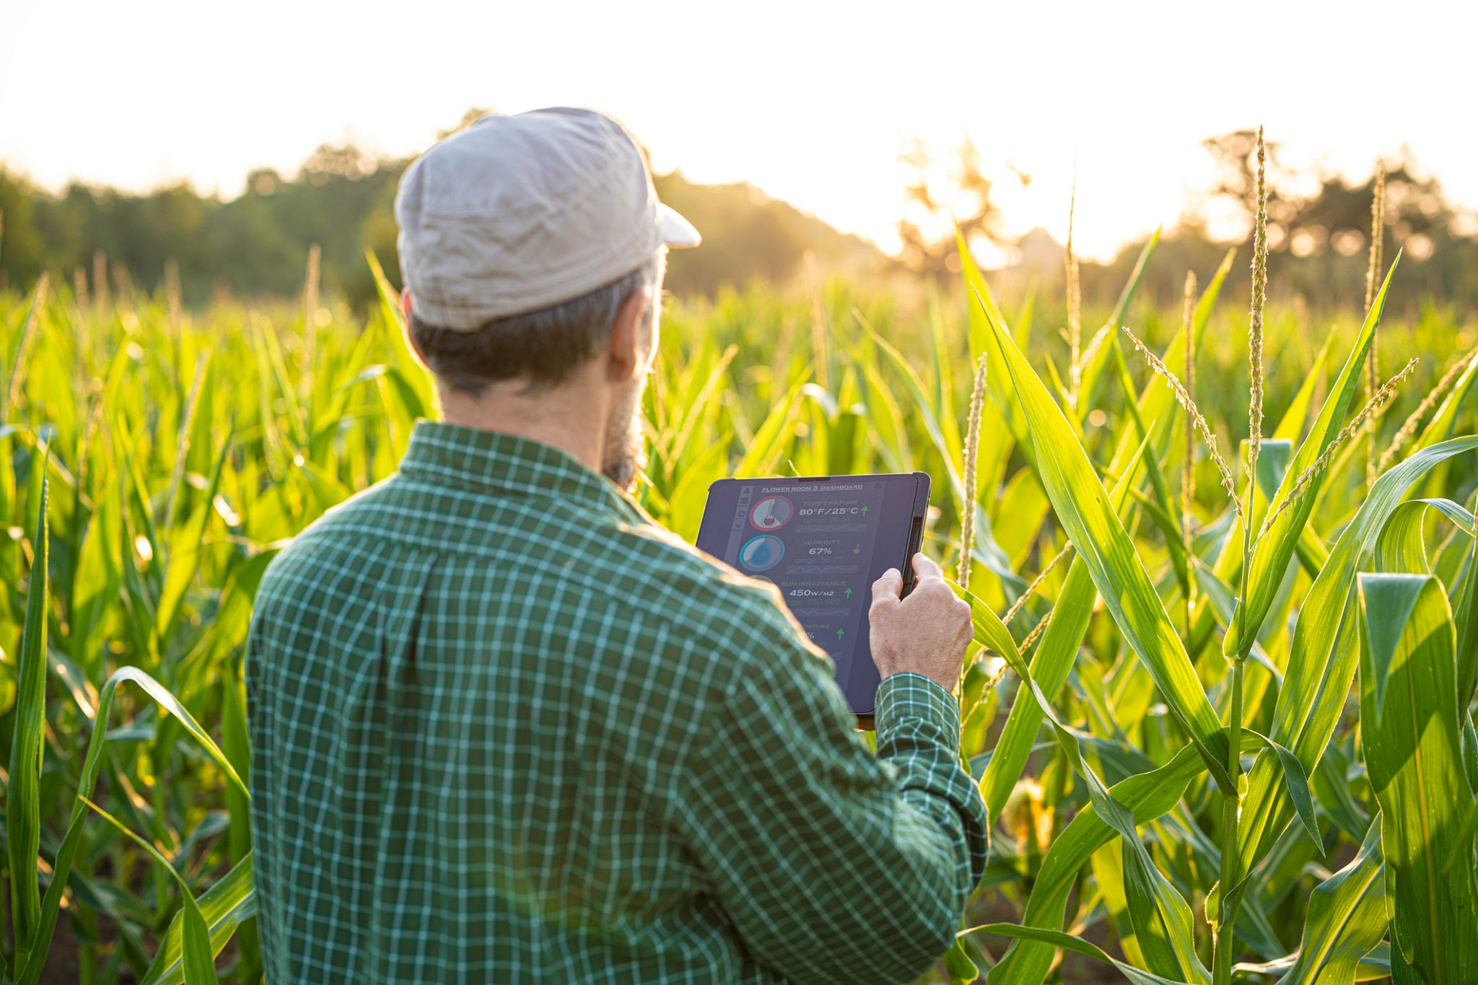
Planning
Areas of Focus:
Algorithm training/design, training our algorithm on the specific data parameters of the dataset
Website/GUI design, buttons, fields, dropdown boxes for user to specify their new data, hosting
User Results and output design, what kinds of predictions will users see? What suggestions will be made to them? Using algorithm to generate results
Gradient Descent and Featured Normalization - We anticipate using similar to a linear regression model which utilizes gradient descent, optimized with featured normalization
Distribution of Work: 3 Phases - Data Cleaning, Implementation, and Testing/Debugging

Slide 5
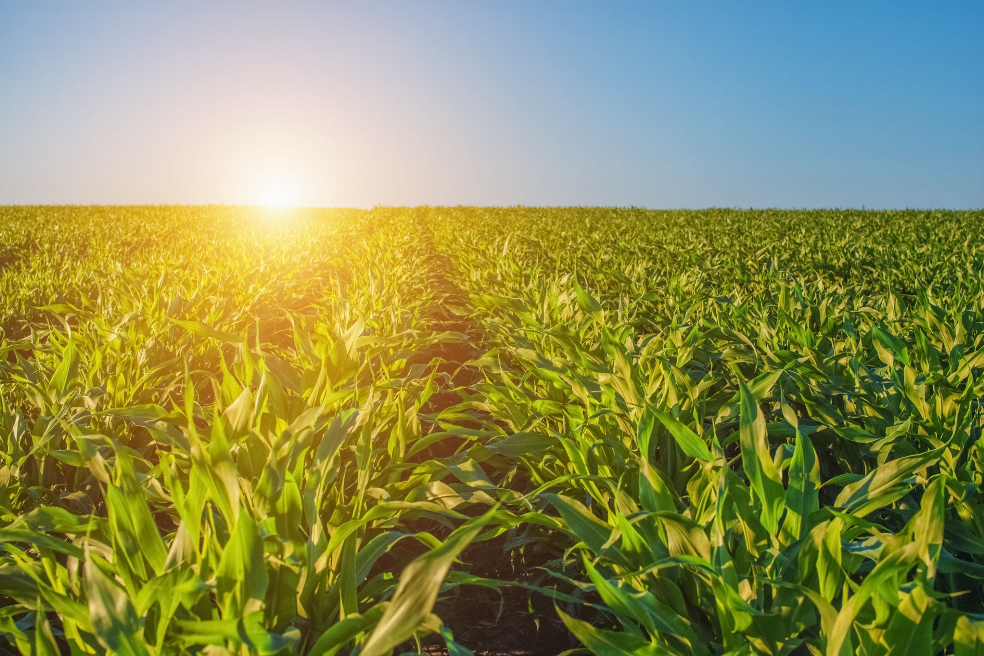
Background and Preparation
Background/Experience/Interests:
HTML, CSS, Python, OOP, Statistics, MatLab, Datasets
Farming, Embedded Systems, & IoT
Tools/Libraries/Techniques:
MatLab, Python, HTML, CSS, VSCode, Github
New Things To Be Learned:
React.js, Farming yield suggestions
Utilizing Sensors and optimizing with AI/ML
Web hosting/deployment, Vercel

